Slide 1

MIS 547
Cloud Computing

Slide 2

Admin
Assignment 6 Due Monday at 11:59pm
01
Quiz 6 Due Sunday at 11:59pm
02
UPDATE: Group Projects Mid-Semester Update Due October 31
03
Revised Assignment Due Dates in D2L
04

Slide 3
Lecture 13
Infrastructure as Code

Slide 4
What is Infrastructure as Code?
The practice of provisioning and managing infrastructure using code, as opposed to doing it interactively, or with non-code automation tools (scripting).
So far, we’ve provisioned infrastructure interactively (manually) using:
GUI (Cloud Consoles)
CLIs
These are examples of manual processes

Slide 5
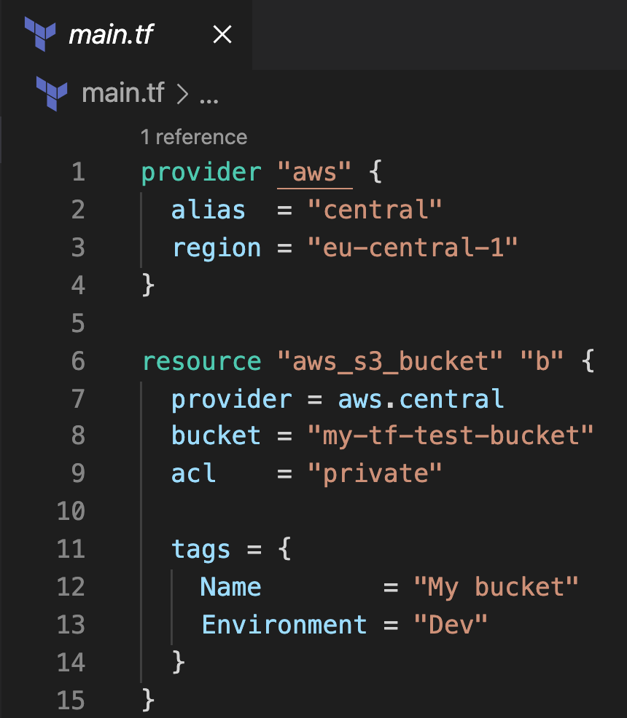
What Is Infrastructure as Code?
Key ideas:
We use code to define resources (everything is defined as code!)
Use version control to manage changes
Continuously test and deliver work in progress
Build small, simple pieces that you can change independently

Slide 6
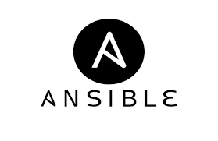
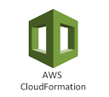


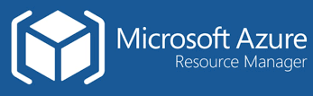


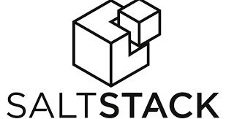

What is Infrastructure as Code?
Major Tools:
Terraform
Pulumi
CloudFormation
Azure Resource Manager
Google Cloud Deployment Manager
Ansible
Chef
Puppet
SaltStack

Slide 7
WHY ARE WE LEARNING THIS?
Notes:
Here is where we start to take a moment and talk about the downsides of cloud computing
Up until now, we’ve talked a lot about scalability, efficiency, cost optimization, going global in minutes!!!
But when the rubber meets the road, it’s not such a rosy picture.
There are tons of pitfalls in cloud computing, and today we’re going to use IaC as a way to explore those.

Slide 8
Why Are We Learning This?
IaC improves our products and developer experiences, and keeps cloud strategy aligned with business strategy
Developer pain points
01
Risks from cloud misconfiguration
02
Business strategy alignment
03

Slide 9
Developer Pain Points
CLI
Console
Configuration
Did you accidentally run a command twice?
Did you have difficulty with SSH keys?
Did you struggle to find the droplets that belonged to your assignment?
Did you have to hunt around to create resources?
If I asked you today to recreate the exact VM we spun up, would you be able to do it?
How much time did you spend installing software on top of the OS and configuring settings before you could launch your Jupyter notebook?
What other issues have you had when working with cloud resources on any platform?

Slide 10
You’re Not the Problem.
This lowkey sucks for everyone

Slide 11

Developer Pain Points, Cont.
What’s wrong with using manual processes (CLI, GUIs)?
Inconsistent implementation
Repeatability is difficult
Error prone
Testing?!

Slide 12
Why Is Testing a Problem For Infrastructure?
How Often Does Our Infrastructure Actually Change?
Can’t We just Set it Up and Run it?

Slide 13
Why Is Testing a Problem? How Often Does Our Infrastructure Actually Change?
A new application feature requires a new data processing tool
A new application feature needs you to upgrade to a newer version of a messaging service
Performance profiling shows that your current architecture is limiting performance.
You need to redeploy applications globally
A newly announced security vulnerability in system packages for your system.
You identify a configuration change that improves the performance of your database.
Example Scenarios

Slide 14
Developer Pain Points
Other pain points your teams are going to run into using manual processes:
Waiting for cloud sysadmins to correctly and securely provision infrastructure before you can work
Lack of consistency across dev/test/prod environments
Lack of consistency across different regions around the world

Slide 15
Cloud Misconfigurations

Slide 16
Cloud Misconfigurations
Cloud misconfigurations are the biggest threat to cloud security according to the NSA
IBM X-Force Cloud Threat Landscape Report found cloud vulnerabilities grew 28% from 2021-2022
Stanford University found that 88% of data breaches are caused by human error.

Slide 17
Cloud Misconfiguration Risks
Data breaches
Service disruptions
Data loss
Compliance violations
Financial impacts
Reputation damage
Operational complexity
Insider threats

Slide 18
Cloud Misconfiguration Risks: Data Breaches
Unauthorized Access
Data Exposure
Misconfigured access controls can lead to unauthorized users gaining access to sensitive data.
Inadequate security settings may inadvertently expose databases, storage buckets, or other resources containing sensitive information to the public internet.

Slide 19
Cloud Misconfiguration Risks: Service Disruptions
Downtime
Resources
Misconfigurations may lead to resource overutilization, such as excessive CPU or memory usage, impacting service performance.
Improperly configured resources can result in service outages, causing disruptions to business operations.

Slide 20
Cloud Misconfiguration Risks: Data Loss
Data Deletion
Lack of Redundancy
Misconfigured redundancy and failover settings may result in data loss during system failures
Inadequate backup and retention policies can result in accidental data deletion, leading to permanent data loss.

Slide 21
Cloud Misconfiguration Risks: Compliance violations
Regulatory Non-compliance
Data Protection Laws
Violations of data protection laws, such as GDPR, can result in hefty fines for mishandling personal data.
Misconfigurations may cause organizations to fail to meet industry-specific compliance requirements, leading to legal and financial penalties.

Slide 22
Cloud Misconfiguration Risks: Financial Impacts
Cost Overruns
Billing Errors
Incorrectly configured billing settings can result in inaccurate billing and financial losses.
Improperly configured resources can lead to unexpected costs, as cloud services may be provisioned but not effectively managed or terminated

Slide 23
Cloud Misconfiguration Risks: Reputation Damage
Customer Trust
Brand Damage
Security breaches and service disruptions due to misconfigurations can damage an organization’s reputation, eroding customer trust.
Publicized cloud-related incidents can negatively impact brand image and customer confidence.

Slide 24
Cloud Misconfiguration Risks: Operational Complexity
Difficult Debugging
Scalability Challenges
As cloud environments grow, managing misconfigurations becomes increasingly challenging, potentially leading to more significant risks.
Identifying and rectifying misconfigurations can be time-consuming and complex, causing operational disruptions.

Slide 25
Cloud Misconfiguration Risks: Insider Threats
Insider Exploitation
Malicious insiders can take advantage of misconfigurations to exfiltrate data, compromise systems, or engage in other harmful activities.

Slide 26

Configuration Drift
Configuration drift is variation that happens over time across once identical systems.
Examples: multiple OS, OS versions, DBs, other technologies
There will be some tension between allowing teams to choose technologies and solutions that are appropriate for their needs, versus keeping the amount of variation in the organization to a manageable level.

Slide 27
Business & Infrastructure Strategy Alignment
Well-managed cloud infrastructure enables business strategy.
Poorly managed cloud infrastructure can bankrupt businesses.

Slide 28
Why Does Our Infrastructure Strategy Matter?
Customer value
Organization strategy
Product strategy
Technology strategy
Infrastructure strategy
DRIVES
ENABLES

Slide 29

Why Does Our Infrastructure Strategy Matter?
In most orgs there is a gap between people interested or knowledgeable in cloud infrastructure and people interested in organizational strategy.

Slide 30
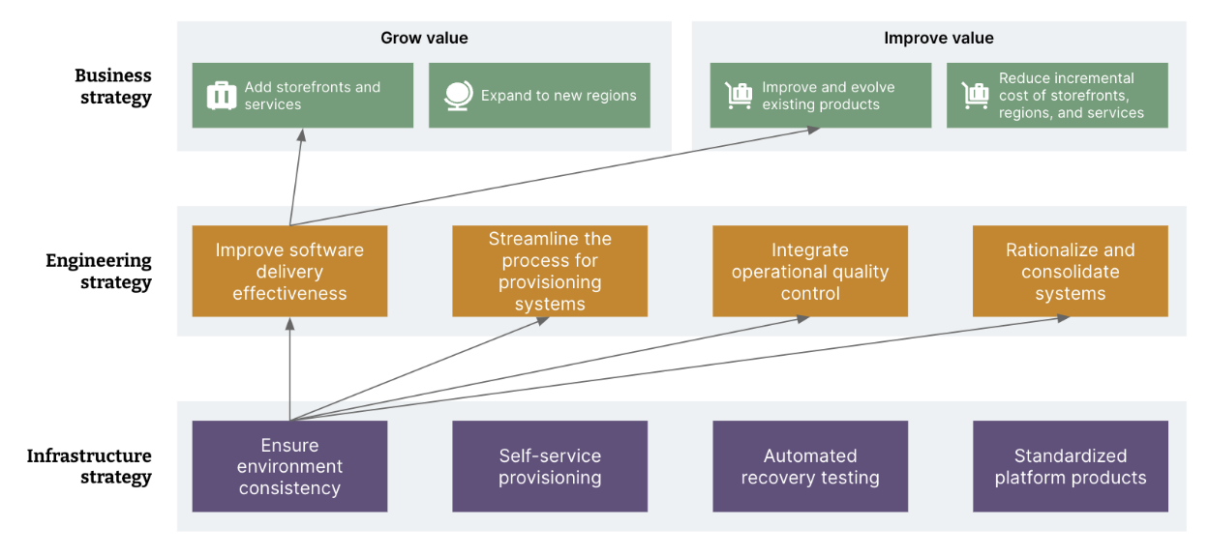
Why Does Our Infrastructure Strategy Matter?
Source: Morris, K. Infrastructure as Code, 3rd Edition. O’Reilly Media, 2023.

Slide 31
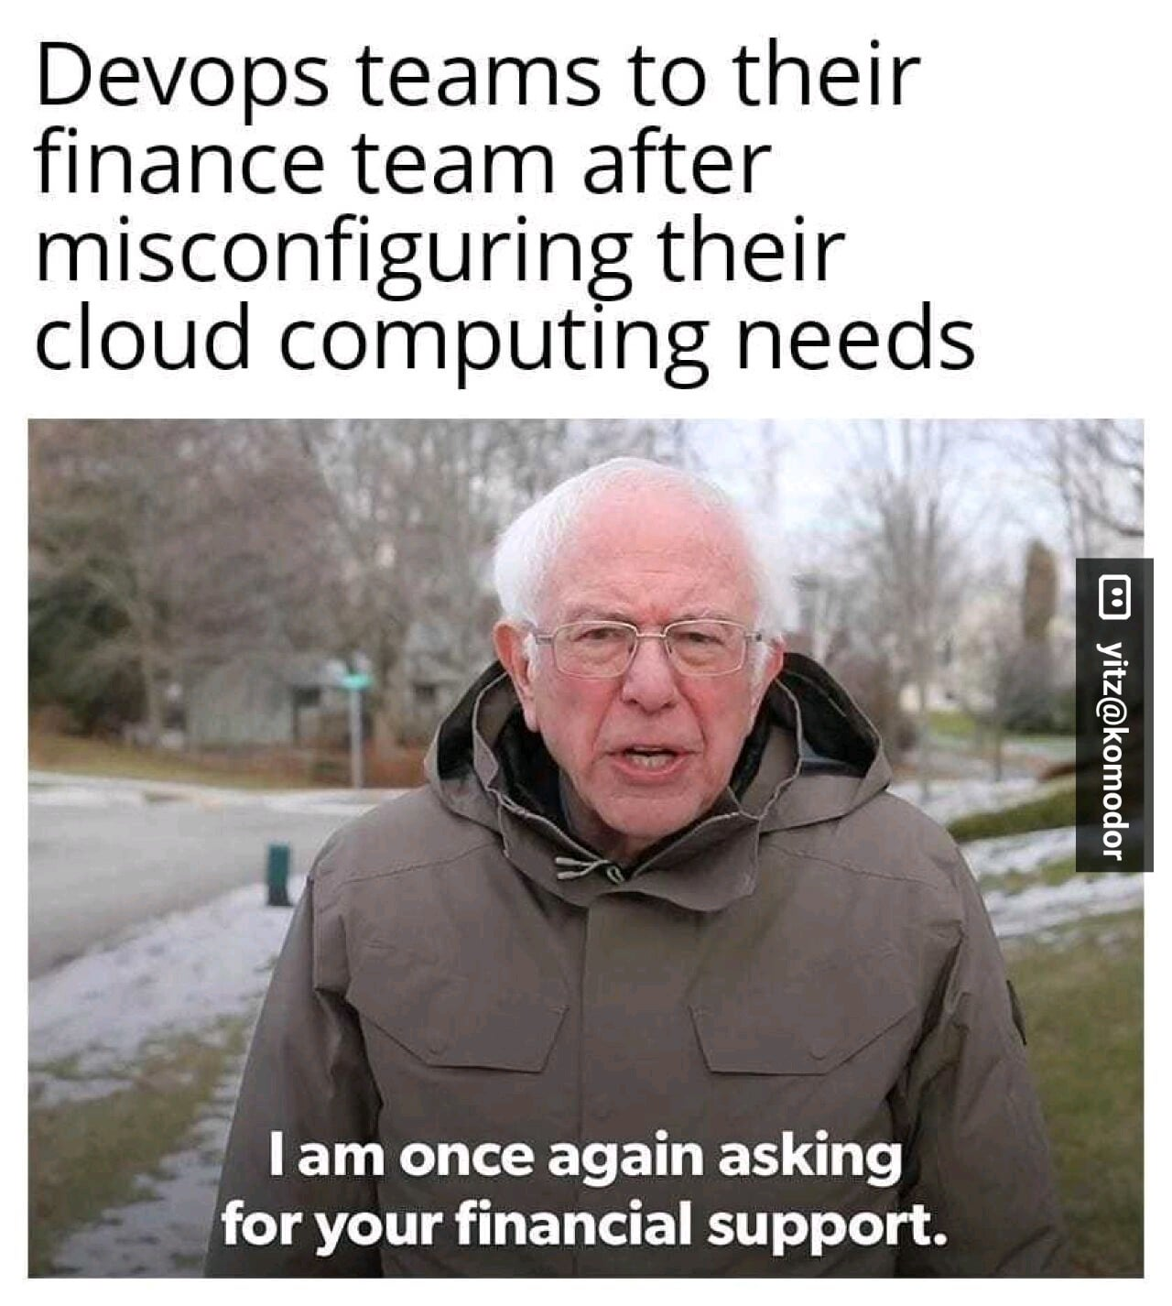
Why Does Our Infrastructure Strategy Matter?
Need to find sustainable ways to grow and evolve
Move fast and break things?
…but shareholders still want us to move fast
Cloud computing costs can become astronomical.
See Cloud Jail reading

Slide 32
Is Infrastructure as Code a Silver Bullet?
No, of course not.
But it gets us closer to where we need to be.

Slide 33
Infrastructure As Code Using Terraform

Slide 34
IAC Tools
Major Tools | Provider | Configuration management | Declarative or Imperative? | Domain-Specific Language?
Terraform | Agnostic (many providers available) | No | Declarative | HCL
CloudFormation | AWS | Yes | Declarative | -
Azure Resource Manager | Azure | No | Declarative | -
Google Cloud Deployment Manager | GCP | Yes | Declarative | -
Ansible | Agnostic | Yes | Imperative | Python DSL
Chef | Agnostic | Yes | Imperative | Ruby DSL
Puppet | Agnostic | Yes | Declarative | Ruby DSL
SaltStack | Agnostic (many providers available) | Yes | Both | Python DSL

Slide 35
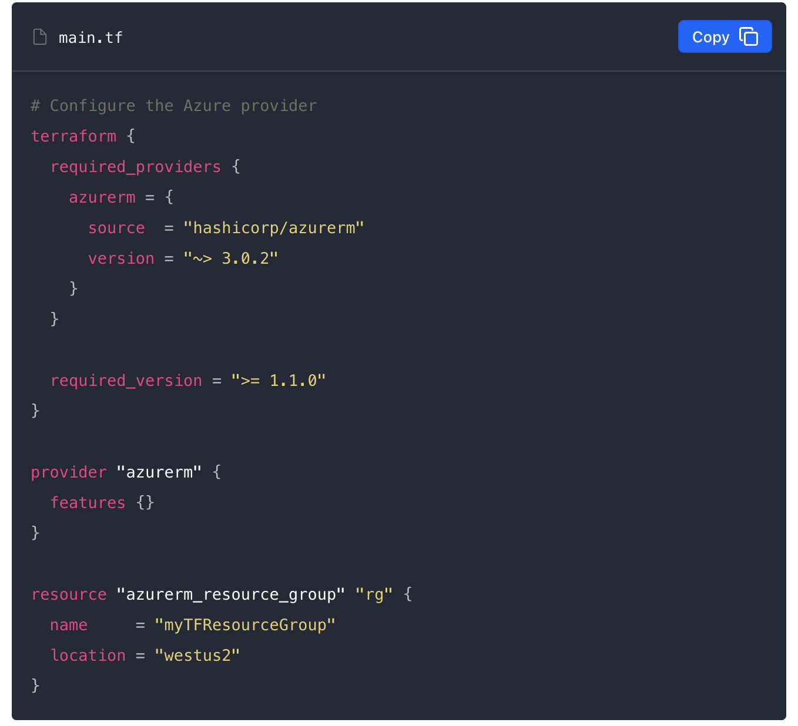
MAIN.tf
terraform {} block:
required_provider: a provider is a plugin that Terraform uses to create and manage resources.
source: optional hostname, namespace, and provider type. This is shorthand for:
registry.terraform.io/hashicorp/azurerm
Note: There are Hashicorp supported providers, vendor supported providers, and community providers!

Slide 36
MAIN.tf
provider {} block:
configures the provider
resource {} block:
defines components of your infrastructure (server, resource group, VPC, etc.)
first string: resource type (“azurerm_resource_group”)
second string: name (“rg”)
Together, the resource type and the resource name form a unique ID for the resource:
azurerm_resource_group.rg

Slide 37
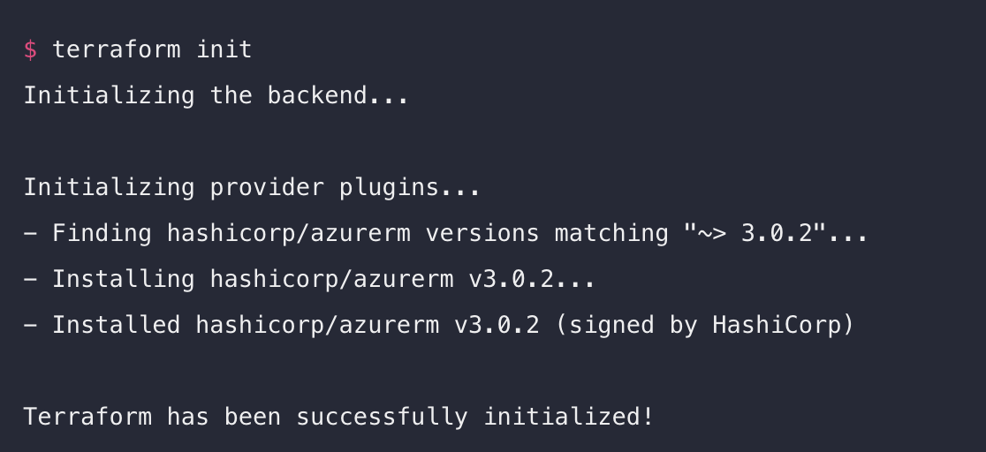
Terraform init

Slide 38
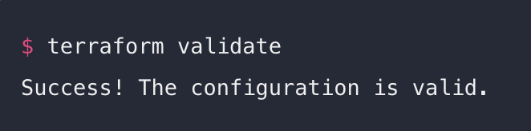
Next Steps:
terraform fmt
terraform validate

Slide 39
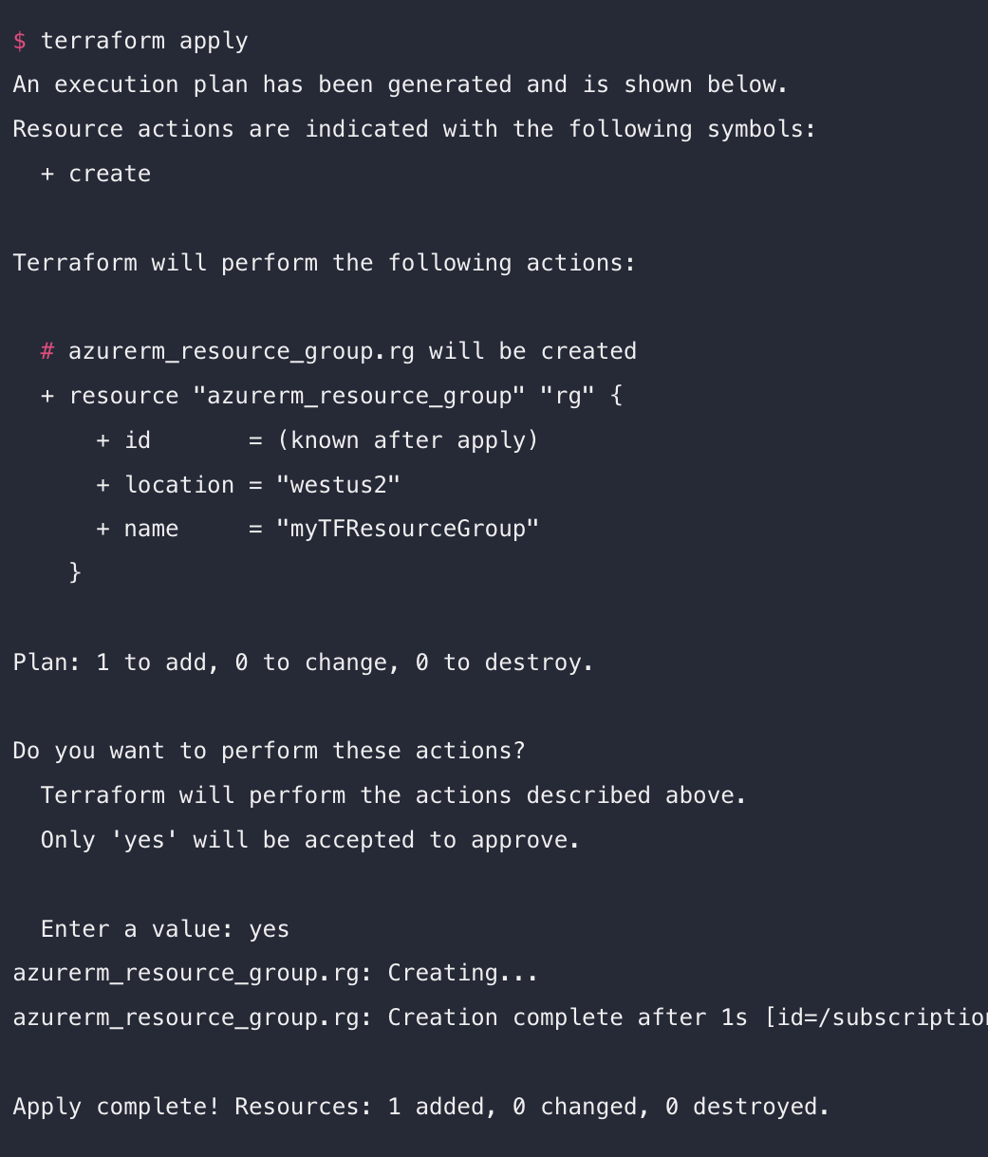
Terraform Apply
You have provisioned your resources and you can now see them in the management console!

Slide 40
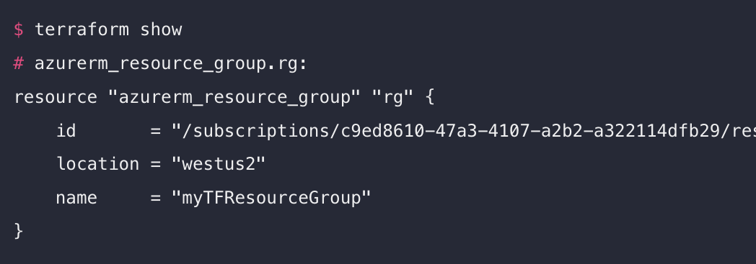
Inspect State Using terraform show
When you apply the configuration, Terraform writes data into a file called terraform.tfstate.
Contains the IDs and properties of the resources Terraform created so that it can manage or destroy these resources going forward.

Slide 41
Managing State
What if you’re collaborating on infrastructure with a team?
We use the same version control practices for IaC that we do for application development!
GitHub, GitHub Actions
It’s recommended to work in branches to avoid colliding with colleagues’ work.
Note: DO NOT CHECK terraform.tfstate IN TO SOURCE CONTROL
For teams or larger projects, consider storing your state remotely (Terraform cloud)

Slide 42
What if we rerun that same configuration?
Idempotence:
The property of certain operations in mathematics and computer science whereby they can be applied multiple times without changing the result beyond the initial application.
An operation can be repeated or retried as often as necessary without causing unintended effects.
A multiple-step orchestration process composed entirely of idempotent steps can be replayed without side-effects if any part of that process fails.
No changes. Your Infrastructure matches the configuration.
Terraform has compared your real infrastructure against your configuration and found no differences, so no changes are needed.
Apply complete! Resources: 0 added, 0 changed, 0 destroyed

Slide 43
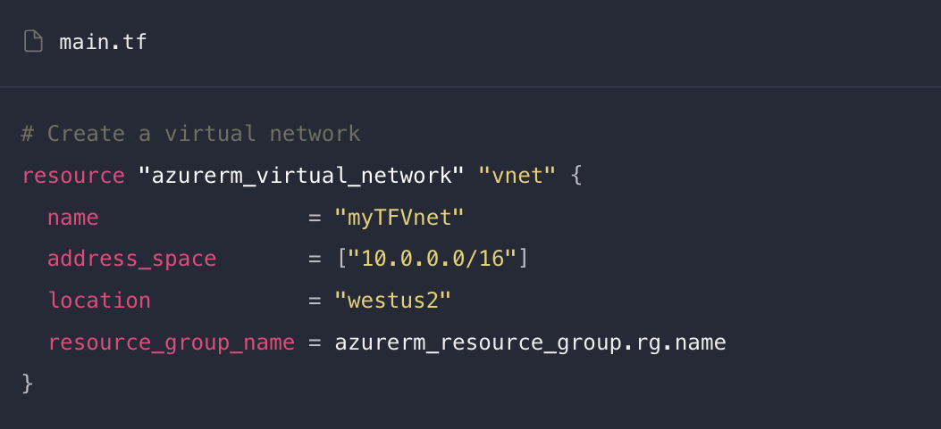
Changing Resources
Add a new resource block to create a virtual network (vnet)
The name of the resource group needs to be included for Azure
This establishes a dependency between the resources.
Terraform ensures that resources are created in the proper order by constructing a dependency graph for your configuration.

Slide 44
Declarative vs Imperative languages
Declarative languages:
Your code defines what you want your infrastructure to look like (how much memory and disk space you want your server to have, and what OS you want to run, etc.)
The tool handles the logic of how to make that desired state come about.
Separation of what you want from how to create it
Imperative languages:
Defines the specific commands needed to achieve the desired configuration, and those commands need to be executed in the correct order.
You think about the configuration as a series of actions or steps.
Many IaC platforms are more strongly rooted in one paradigm but have a mix of both.
Terraform’s language is declarative, and is called HCL

Slide 45
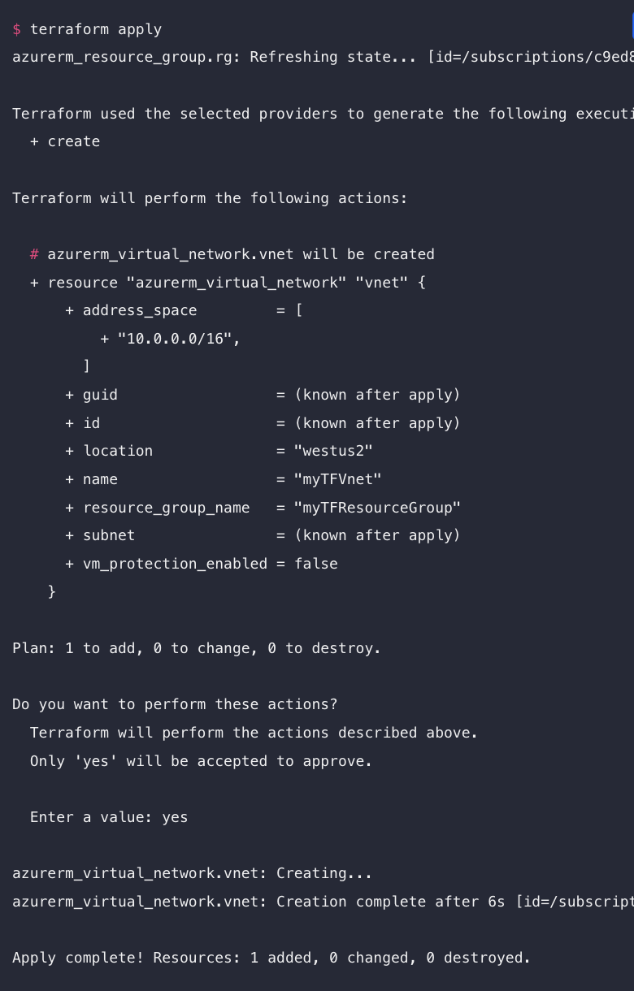
Apply your changes
Terraform builds an execution plan by comparing your desired state (described in configuration that you edited) to the current state (defined in terraform.tfstate file)

Slide 46
Changes: Mutable Vs. Immutable Infrastructure
Immutable: You cannot change an object’s state after creating it.
Mutable: You can change an object’s state after creating it.

Slide 47
Mutable Infrastructure
Pros:
Do not have to build from scratch every time a change is required
Roll out updates for individual servers → updates are faster
Data persistence may be easier initially
Cons:
Can lead to configuration drift
Indiscrete versioning
In-place updates can fail
Debugging can be time consuming

Slide 48
IMMUTABLE INFRASTRUCTURE
Pros
Discrete versioning (you won’t have two versions of the same server running at the same time)
Test different versions and roll out updates all at once
Predictability
Roll back deployments since previous versions are unaffected.
Cons
Cannot modify existing resources
Externalize data storage

Slide 49
Destroying Resources
The terraform destroy command terminates resources managed by your Terraform project.
It does not destroy resources running elsewhere that are not managed by the current Terraform project.
Provides verbose output of each resource that will be destroyed.

Slide 50
Managing your Terraform Project
Even a moderately sized project can result in very long configurations.
There are several ways we can ensure our projects are dynamic, query-able, and organized.
Let’s look at variables, outputs, and modules.

Slide 51
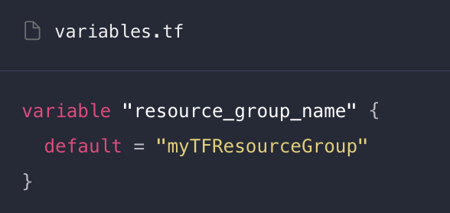
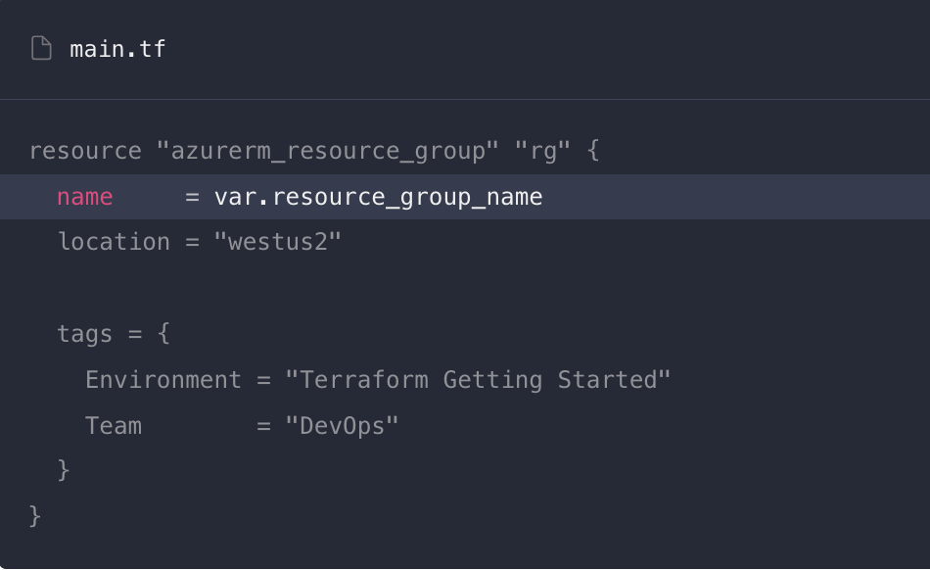
Defining Variables
The examples so far have used hard-coded variables.
Terraform configurations can include variables to make your configuration more dynamic and flexible.
Use a variables.tf file and update your configuration with variables

Slide 52
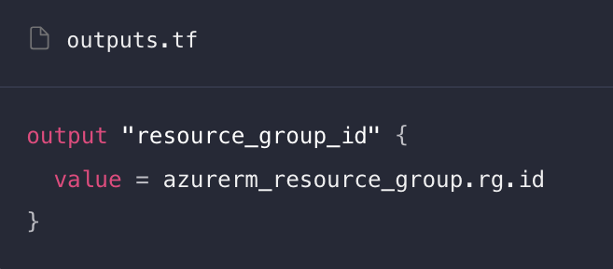
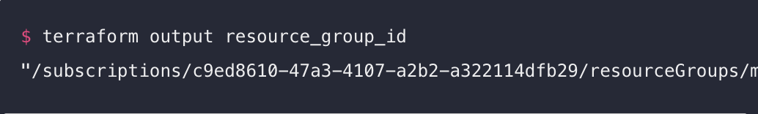
Outputs
Output values help you to organize data to be easily queried and displayed.
Outputs designate which data to display when you need to query variables.
Need to rerun terraform apply after defining the output

Slide 53
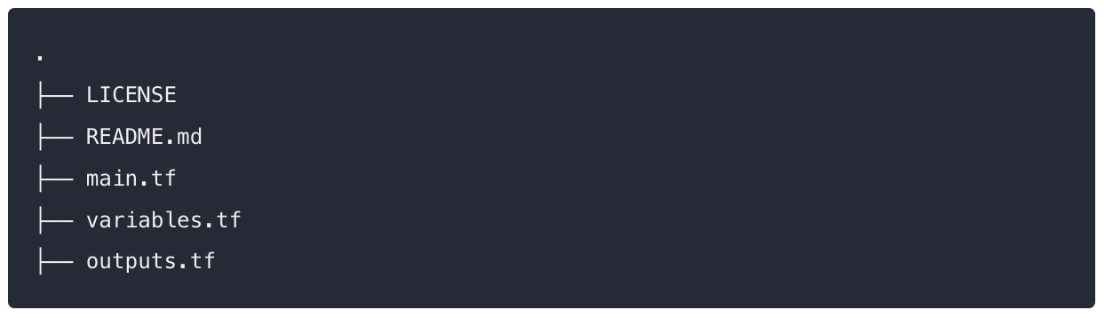
Modules
A Terraform module is a set of Terraform configuration files in a single directory.
When you run Terraform commands directly from the directory, it is considered the root module.

Slide 54
Modules
Modules are similar to the concept of libraries, packages, or modules found in most programming languages and provide many of the same benefits.
Use local modules to organize and encapsulate your code.
Use the public Terraform Registry to find useful modules. Rely on the work of others to implement common infrastructure scenarios!

Slide 55
Best Practices for organizing your project
Place each component you want to configure in its own module folder
Place the .tf module files at the root of each folder and include a README
Use consistent module structure
Use subfolders for documentation, examples, and tests
Place the root module in a separate folder called main
Include descriptions for outputs and variables

Slide 56

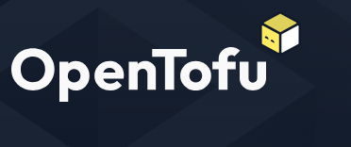
The DRAMAAA
Terraform → OpenTofu
Terraform was open-sourced in 2014 under the Mozilla Public License
August 10, 2023, Hashicorp switched to Business Source License
Terraform was forked on August 25, 2023. That fork was called OpenTF, then was renamed to OpenTofu
It is now maintained by the Linux Foundation!
No difference between Terraform v < 1.5x and OpenTofu. (Currently a drop-in replacement)
This will change as new versions are released…

Slide 57
More Drama??
HashiCorp acquired by IBM in April for $6.4 Billion dollars.
Other HashiCorp products that are widely used:
Vault

Slide 58
Land Acknowledgement Statement
We respectfully acknowledge the University of Arizona is on the land and territories of Indigenous peoples. Today, Arizona is home to 22 federally-recognized tribes, with Tucson being home to the O’odham and the Yacqui. Committed to diversity and inclusion, the University strives to build sustainable relationships with sovereign Native Nations and Indigenous communities through education offerings, partnerships, and community service.

